Slide 1
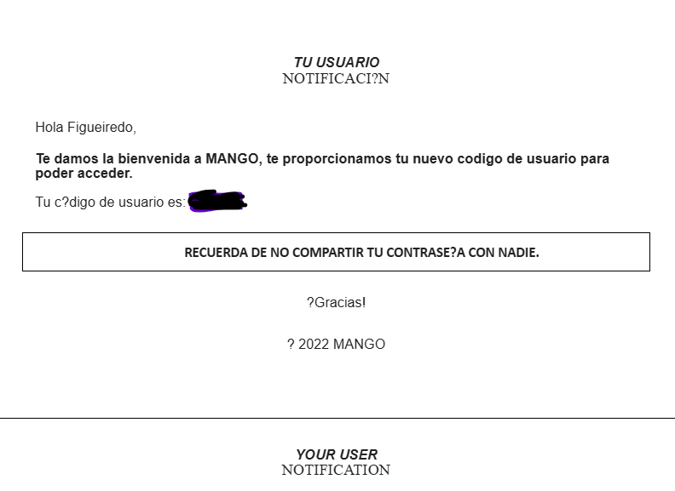

MANGO USER…… WHAT TOOLS?
Remote desktop
Wintegrate
Mango Intranet
Collection Life
Digital Receipts
Givex
Manto
|

Slide 2
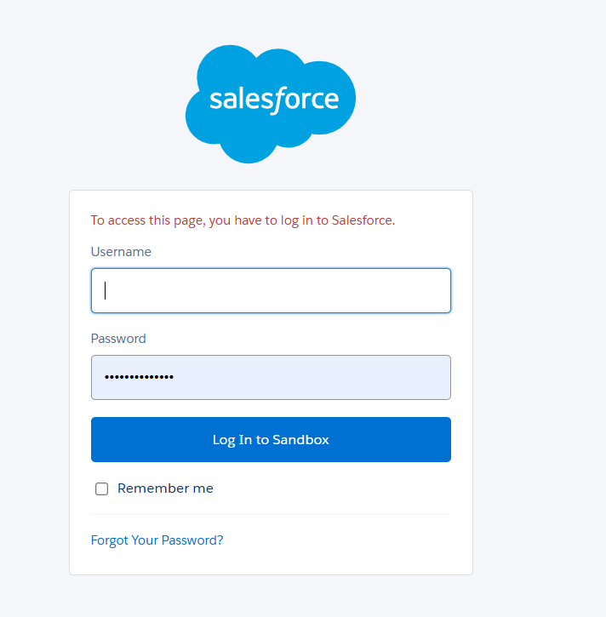
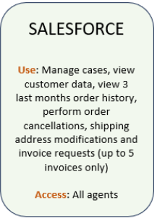
SALESFORCE pre
URL: salesforcepre
User: email TWW - always finishing .pre
password - e-mail sent from support@salesforce.com
on the first login - change password
required: double authentication
for more information: Salesforce Operation Manual (EN)01
|

Slide 3
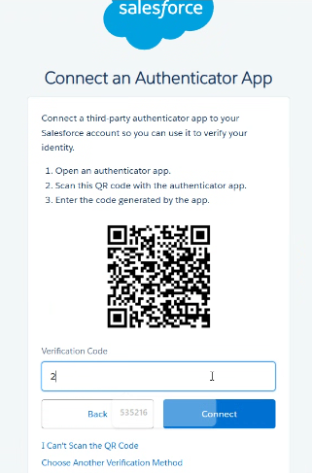
SALESFORCE pro
URL: salesforce pro
User: email TWW
password - e-mail sent from support@salesforce.com
on the first login - change password
required: double authentication
email: xxxxx@transcom.com.mango
for more information: Salesforce Operation Manual (EN)01
|

Slide 4
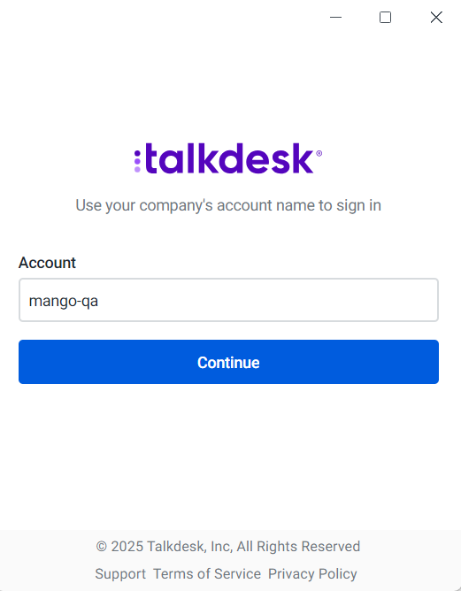
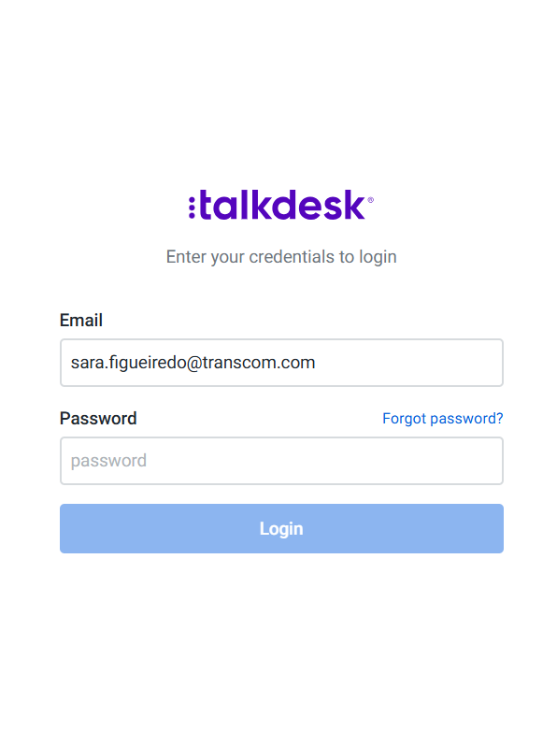
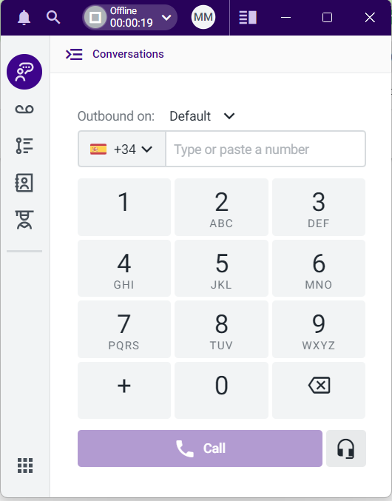
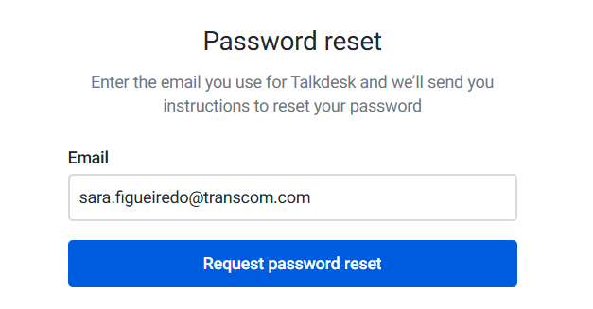
TALKDESK
APP on desktop
first access account: mango-qa
email: TWW email
First Login: click on forget password
|

Slide 5
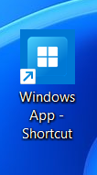
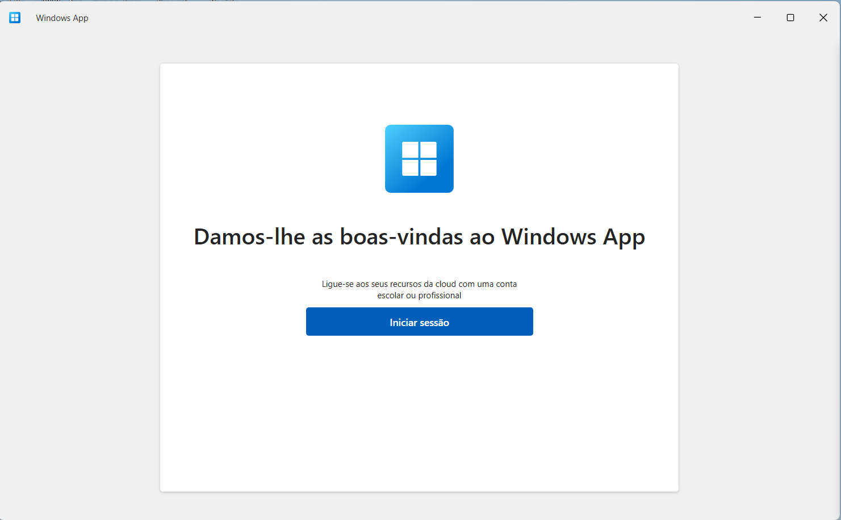
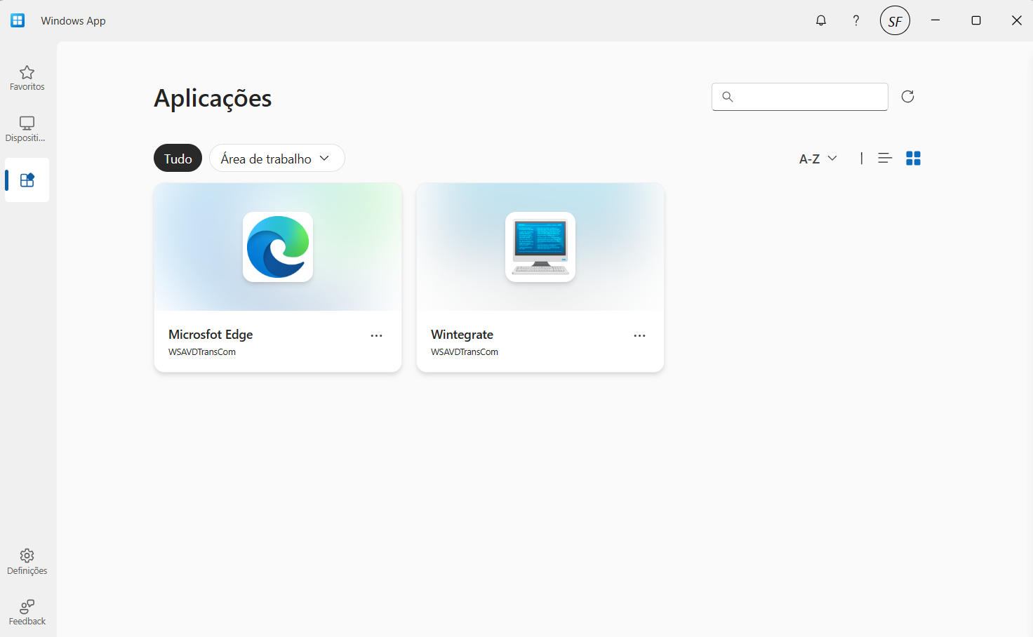
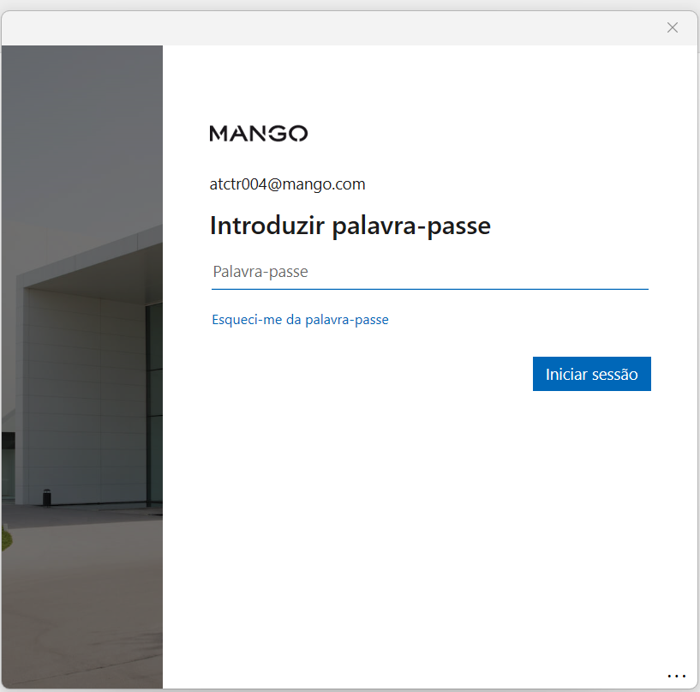
AZURE - REMOTE DESKTOP
Access: from desktop - windows app
User and password sent by: solutions@mango.com
always add @mango.com after the user
|

Slide 6
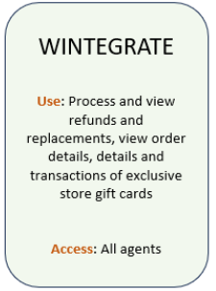
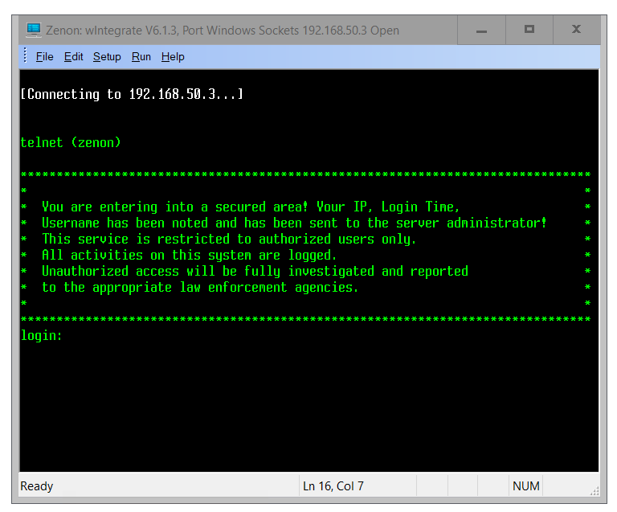
WINTEGRATE
Access in Remote Desktop
LOG IN: sent by solutions@mango.com
ALERT: User blocked for entering the wrong username/password 3 times
to paste - click on edit before
|

Slide 7
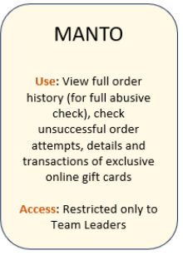
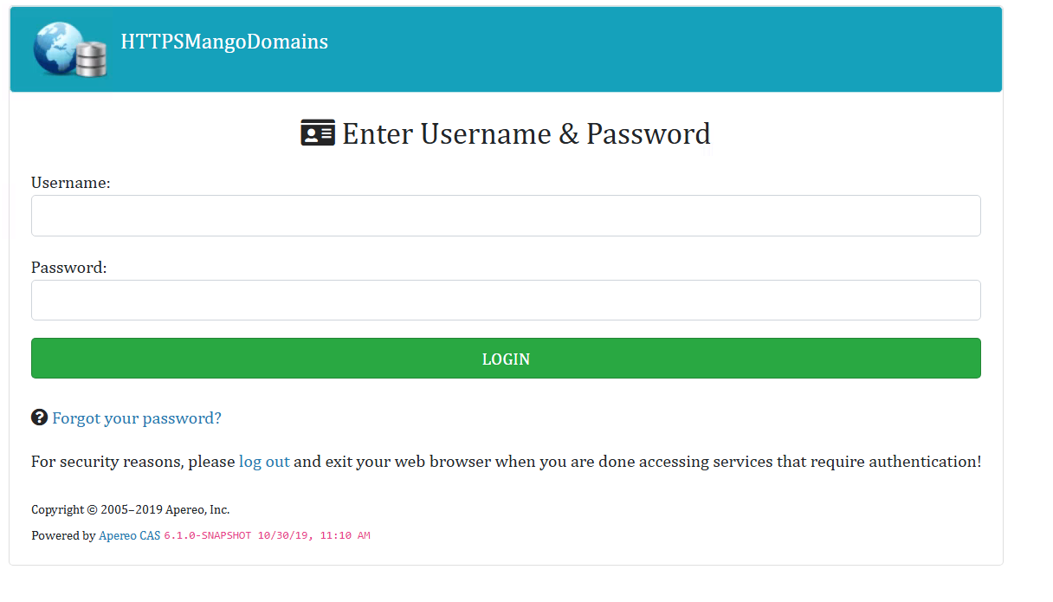
MANTO
URL: Manto
Access in Remote Desktop
access on remote desktop selecting edge
LOG IN: sent by solutions@mango.com
|

Slide 8
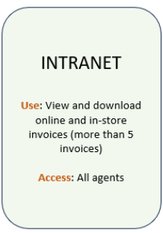
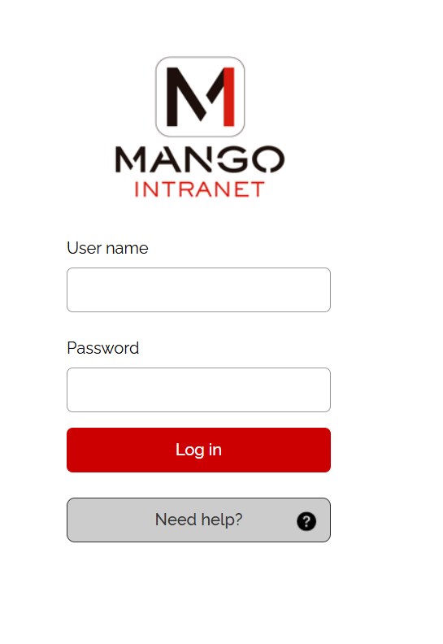
INTRANET
URL: INTRANET
Access in Remote Desktop
LOG IN: sent by solutions@mango.com
User name - do not use @mango.com
|

Slide 9
FOSTER
URL: FOSTER - SAP
|

Slide 10
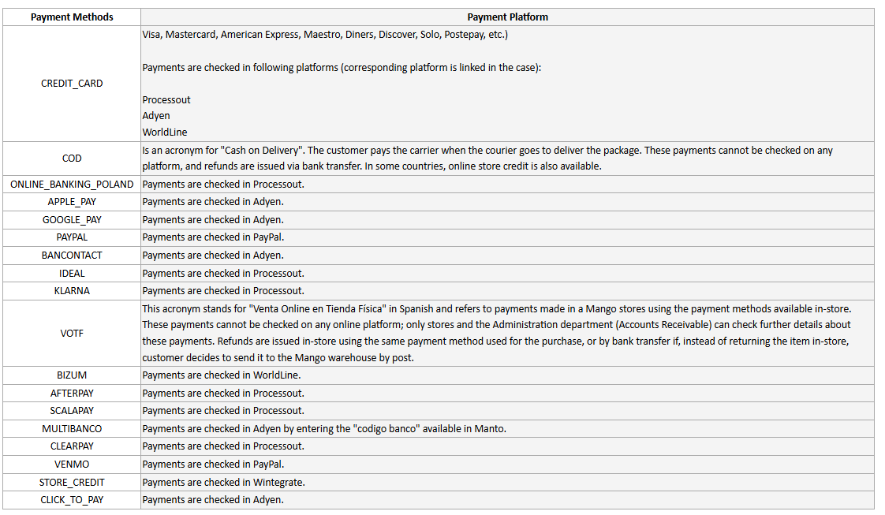
PAYMENT PLATFORMS
all the platforms are linked on SALESFORCE
some need google authenticator
login and password are different in each platform
URL’s:
PROCESSOUT
ADYEN
WORLDLINE
PAYPAL
|

Slide 11
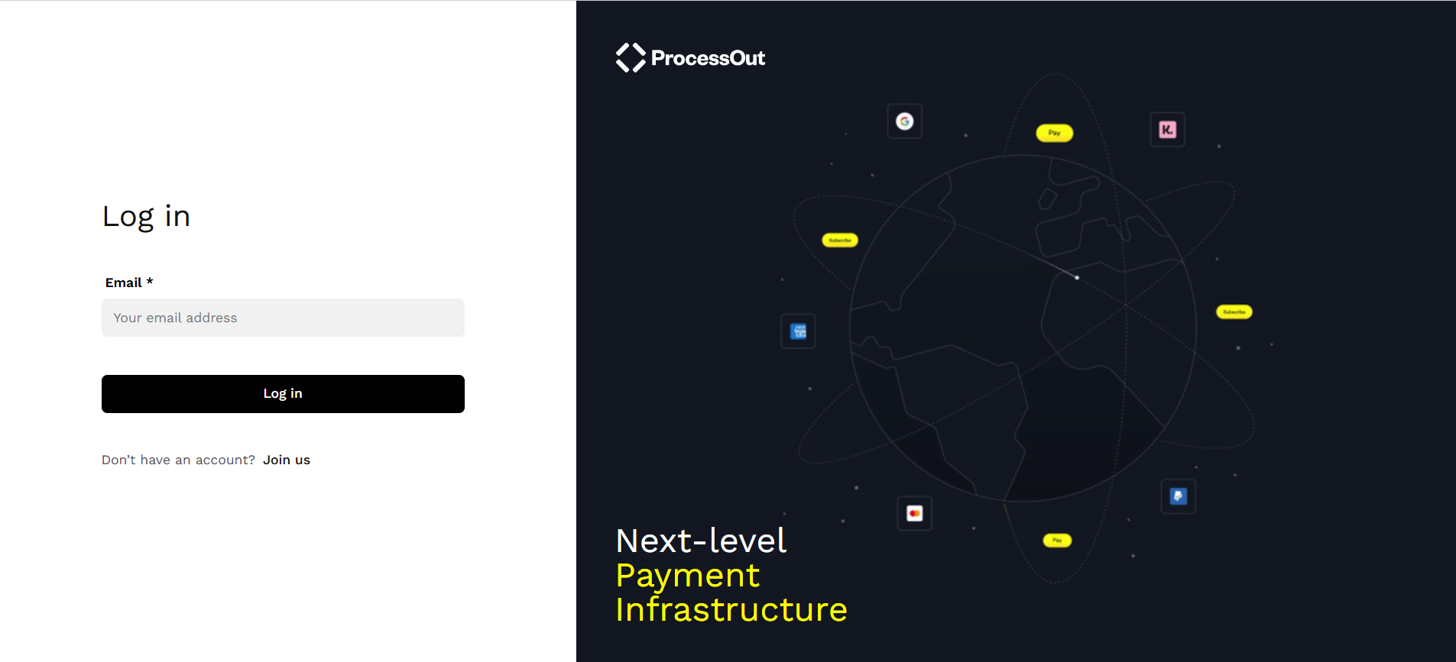
PAYMENT PLATFORM - PROCESSOUT
URL: PROCESSOUT
Processout is the platform to check the details of the payments and refunds of:
Klarna.
Orders from Netherlands with TPV 592.
DotPay.
Scalapay.
USER and PASSWORD: provided on salesforce
Don’t need double authenticator

Slide 12
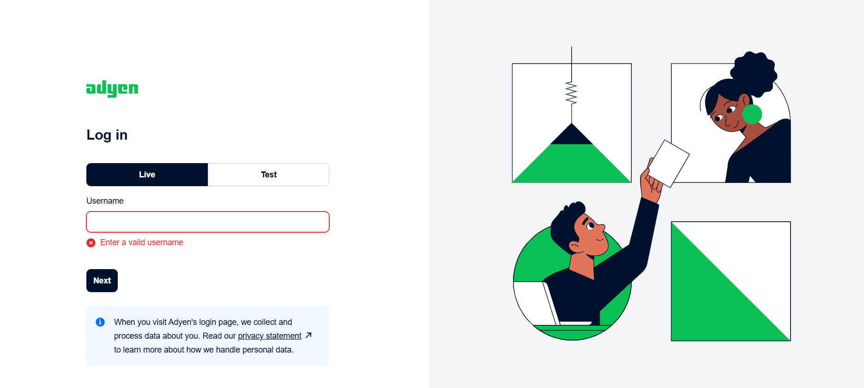
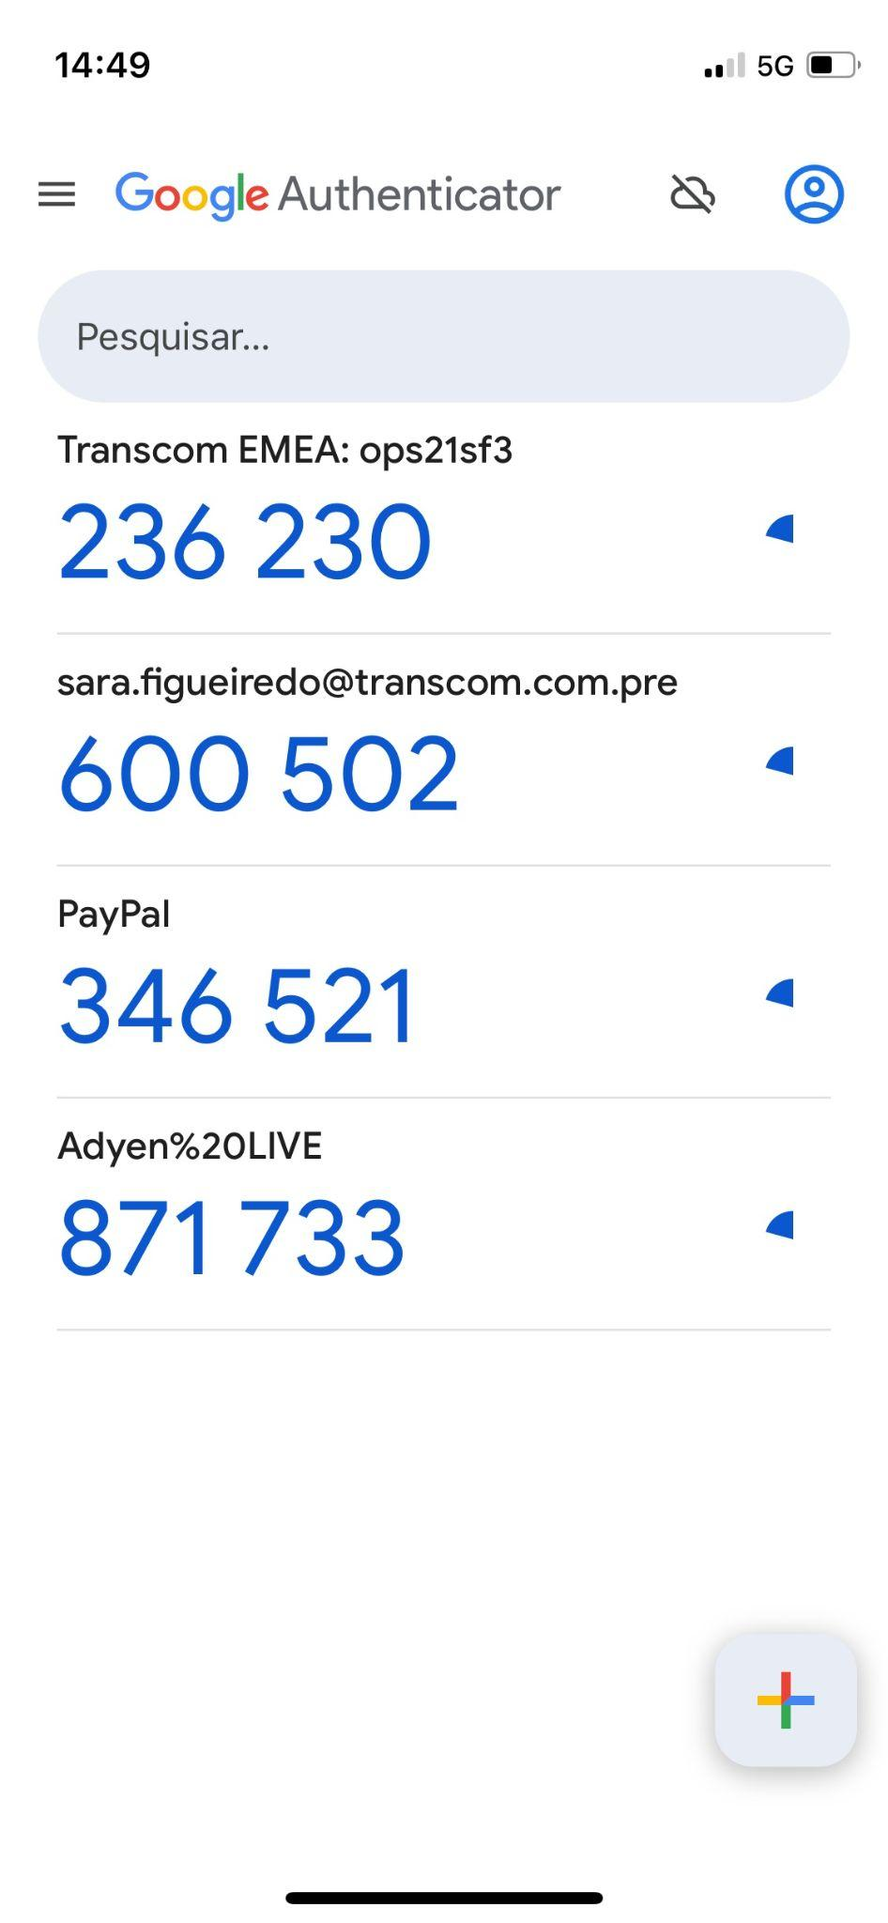
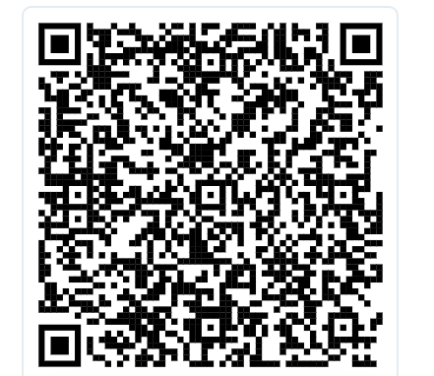
PAYMENT PLATFORM - ADYEN
URL: ADYEN
USER and PASSWORD: provided on salesforce
DOUBLE AUTHENTICATION: After entering the password, it will request a double authentication that must be configured

Slide 13
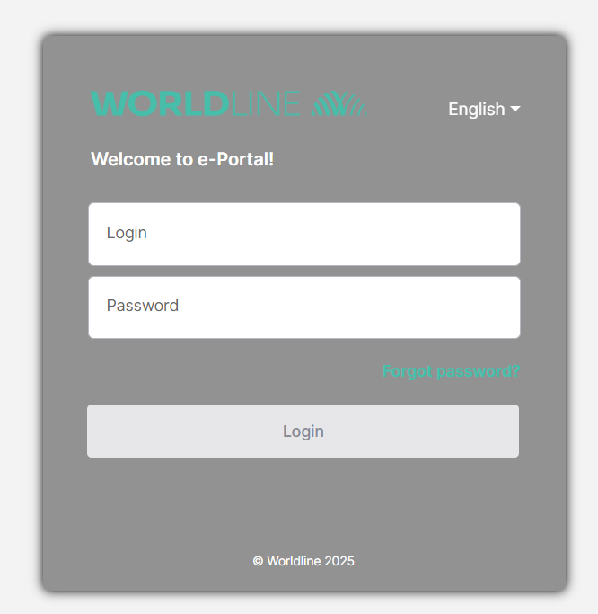
PAYMENT PLATFORM - WORLDLINE
URL: WORLDLINE
On this platform we can check payments and refunds of the following orders:
Mango.com order paid by credit or debit card shipped to Spain (Canary Islands)
Mangooutlet.com order paid by credit or debit card shipped to Spain (Peninsula and Balearic Islands, Canary Islands, Ceuta and Melilla)
All orders paid by Bizum
USER and PASSWORD: provided on salesforce
Don’t need double authenticator

Slide 14
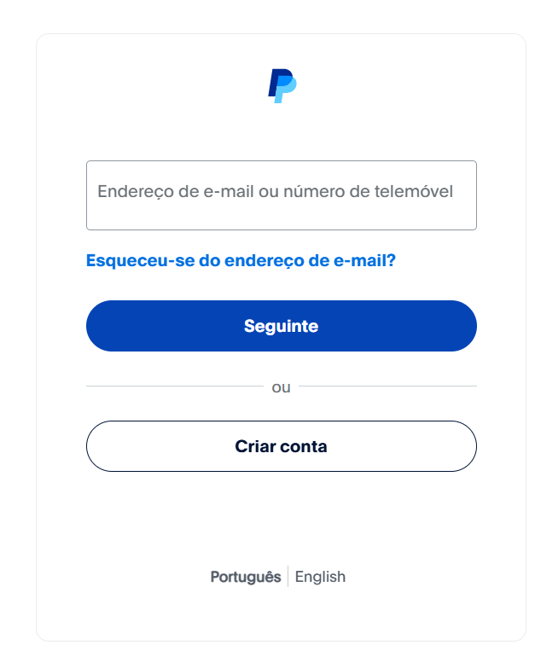
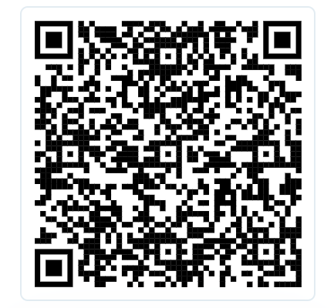
PAYMENT PLATFORM - PAYPAL
URL: PAYPAL
USER and PASSWORD: provided on salesforce
users and passwords vary depending on the country
Need double authenticator

Slide 15
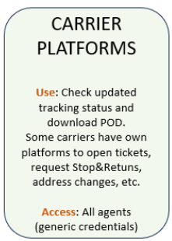
TRANSPORT (CARRIERS) PLATFORMS
all the platforms are linked on SALESFORCE
some need google authenticator
login and password are different in each platform
URL’s:
REBOUND
EVRI - HERMES
GLS Spain
SEUR
|

Slide 16
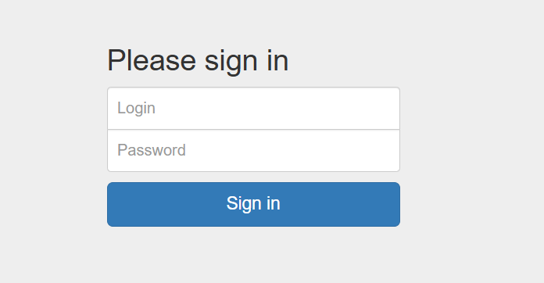
TRANSPORT (CARRIERS) PLATFORMS - REBOUND
URL: REBOUND
USER and PASSWORD: provided on salesforce
Manages the return packages of www.mango.com and www.mangooutlet.com orders that customers send (with prepaid label, home collection or by mail at their expense) in some countries.
|

Slide 17
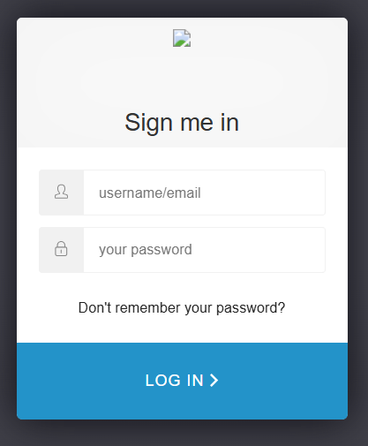
TRANSPORT (CARRIERS) PLATFORMS - EVRI
URL: EVRI - HERMES
USER and PASSWORD: provided on salesforce
|

Slide 18
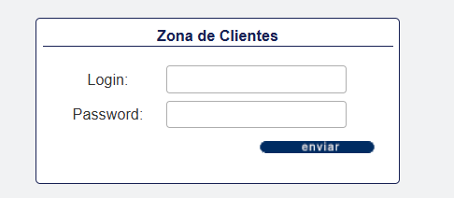
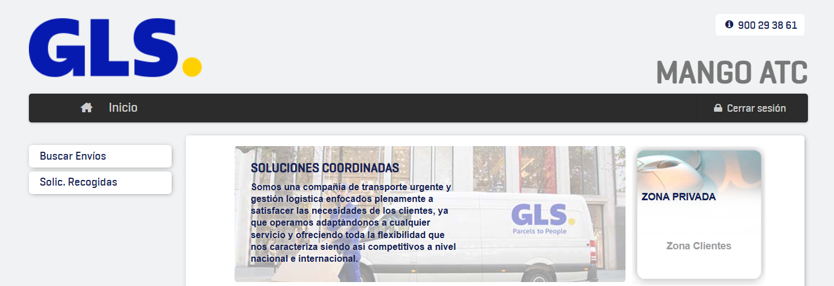
TRANSPORT (CARRIERS) PLATFORMS - GLS
URL: GLS Spain
USER and PASSWORD: provided on salesforce
|

Slide 19
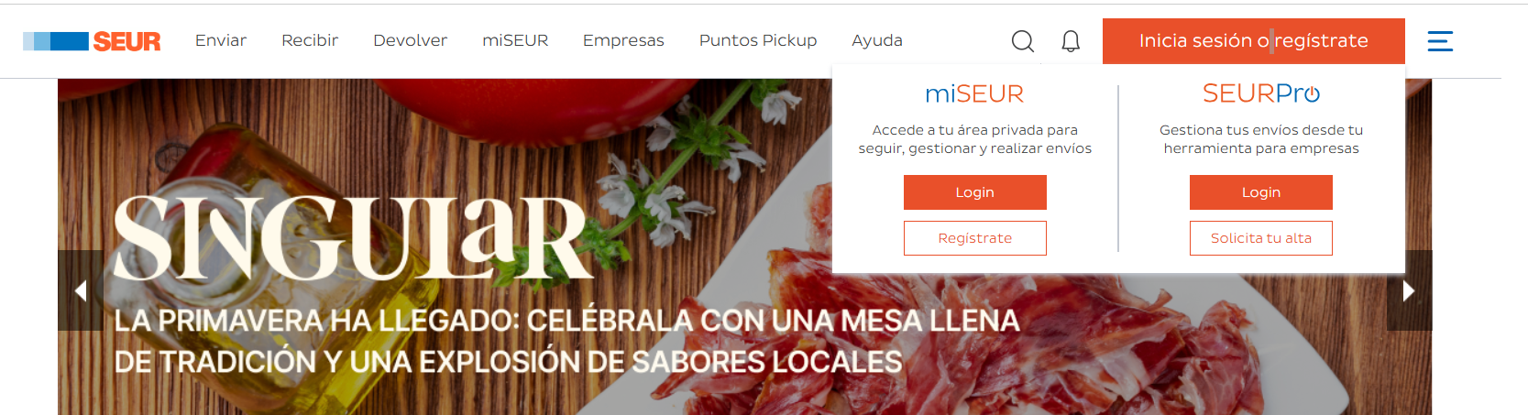
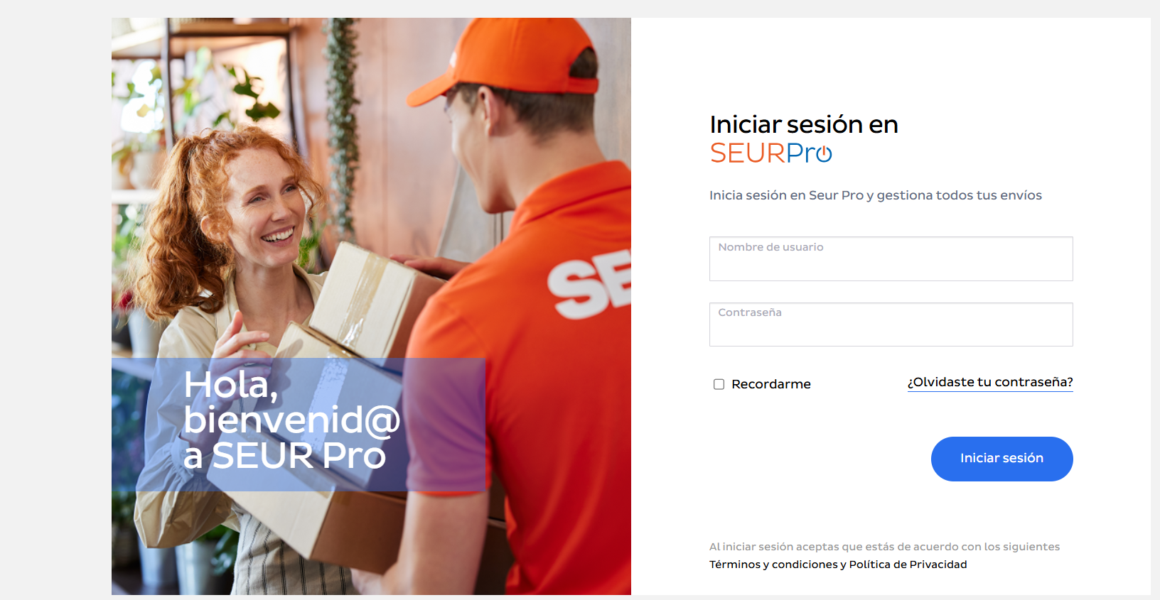
TRANSPORT (CARRIERS) PLATFORMS - SEUR
URL: SEUR
USER and PASSWORD: provided on salesforce
LOGIN at SEUR PRO
|

Slide 20
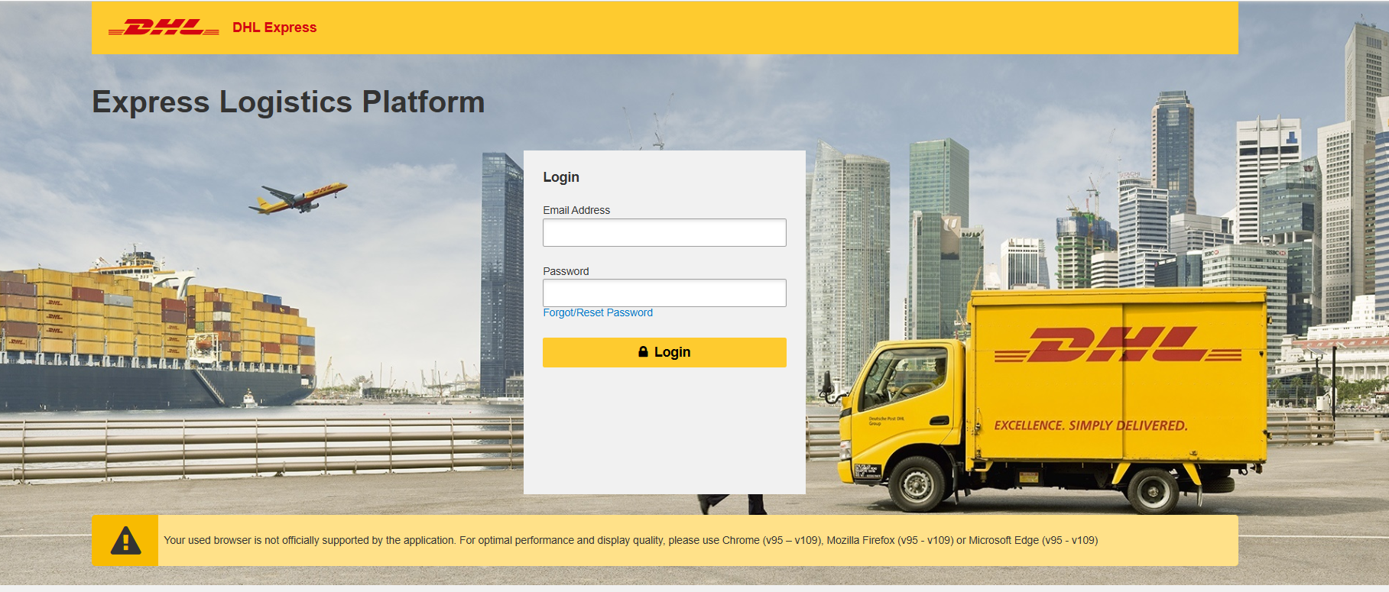
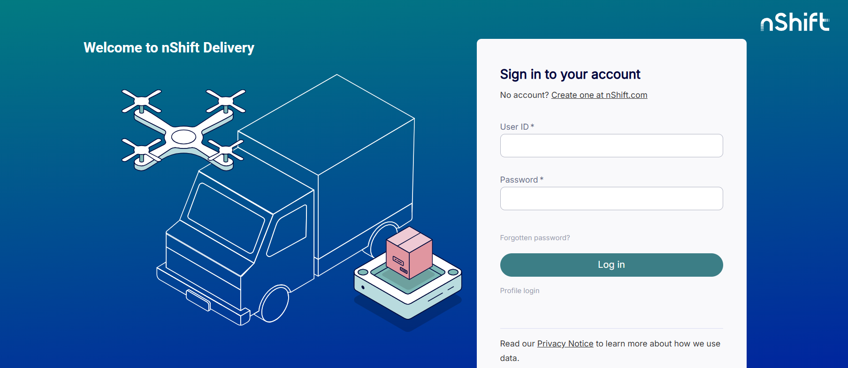
RETURN LABELS
URL: Without return label / Return label request
USER and PASSWORD: provided on salesforce
DENMARK - FINLAND - SWEDEN: UNIFAUONLINE
MEXICO: DHL
|

Slide 21
RETURN LABELS - DENMARK - FINLAND - SWEDEN
URL: UNIFAUONLINE
USER and PASSWORD: provided on salesforce
ACCESS to download the label form
|

Slide 22
RETURN LABELS - MEXICO
URL: DHL
USER and PASSWORD: provided on salesforce
ACCESS to download the label form
|

Slide 23
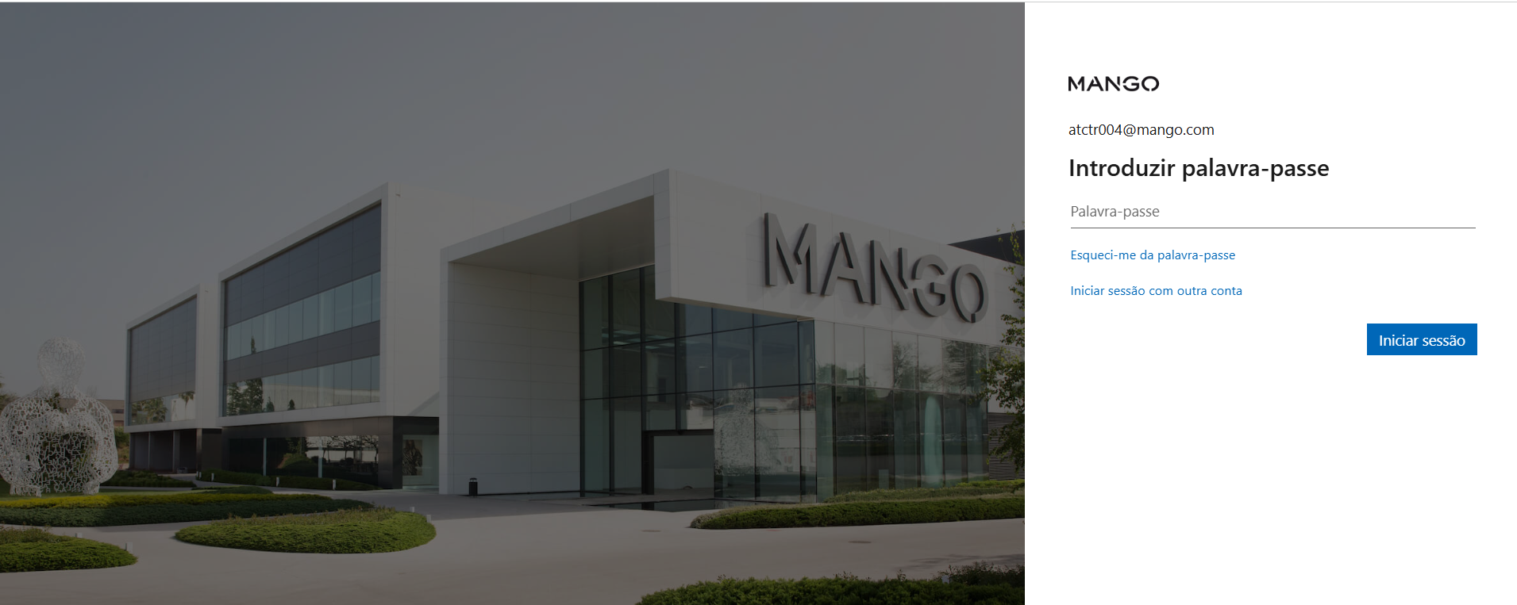
COLLECTION LIFE
URL: COLLECTION LIFE
LOG IN: sent by solutions@mango.com
User name - use @mango.com
|

Slide 24
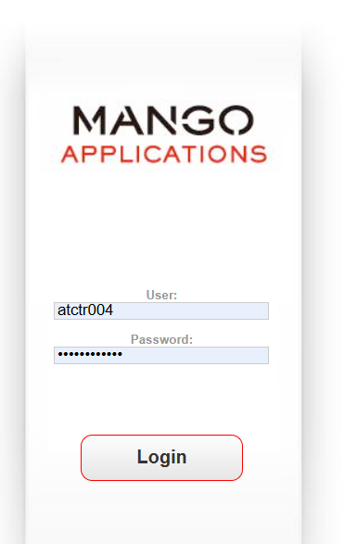
DIGITAL RECIEPTS
URL: APPLICATIONS MANGO
LOG IN: sent by solutions@mango.com
User name - do not use @mango.com
|

Slide 25
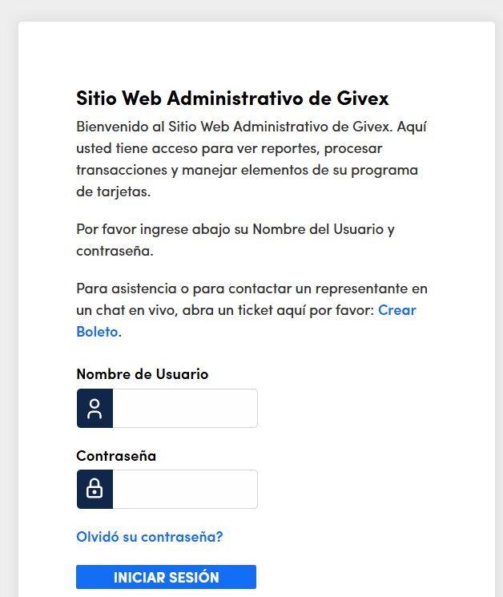
GIVEX
URL: GIVEX
LOG IN: sent by support@givex.com
To see GIFTCARDS
|

Slide 26
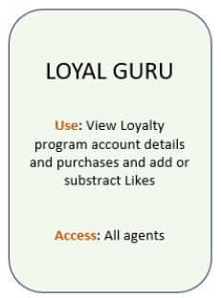
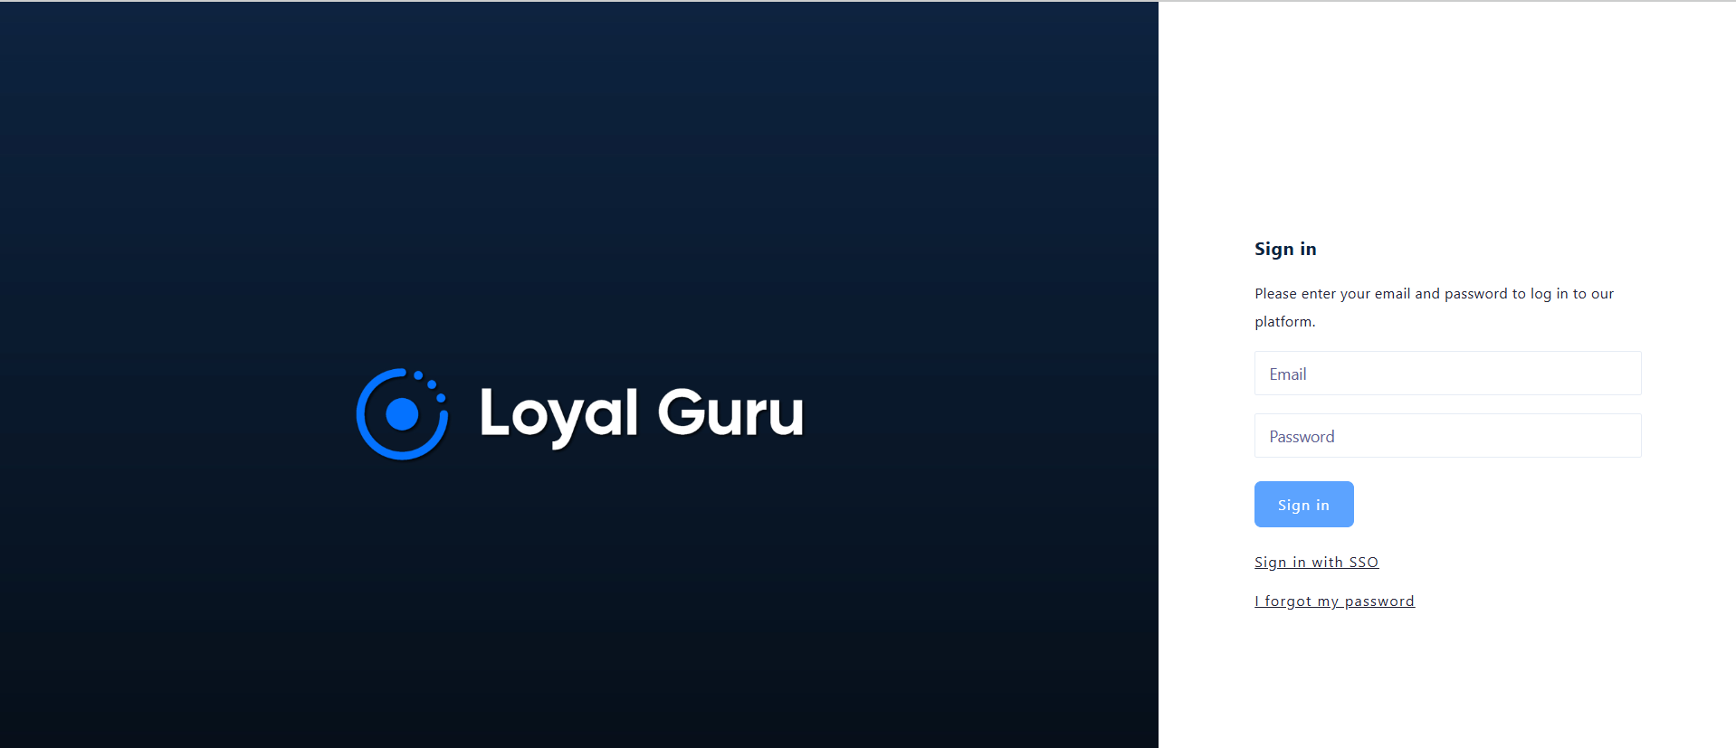
URL: LOYAL GURU
user: received by email info@loyal.guru
in case of email missing: Access with email and personal password in google chrome (not internet explorer).
(you have to add +lg in the email before @. Example: xxxx.xxxx+lg@xxxxxx.com)
click on “forgot password” on the first login
for more info: Loyal Guru (EN) (Client manual)
|

Slide 27
TABLEU
|

